Slide 1
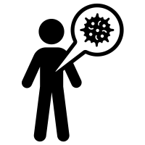

What is the exposure risk?
If this percent of people in your group have HIV.
Sexual partner(s)
Prevalence of HIV
sexual partners
Risk of exposure to HIV
?

Slide 2
What is the Infection risk?
Sexual partner(s)
If this percent of people in your group have HIV.
Prevalence of HIV
Risk of exposure to HIV
sexual partners
https://hivrisk.cdc.gov/risk-estimator-tool/#-sb

Slide 3








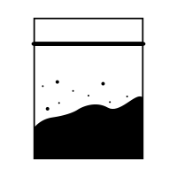


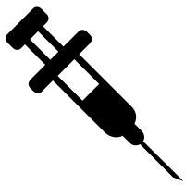

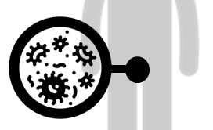





?

Slide 4
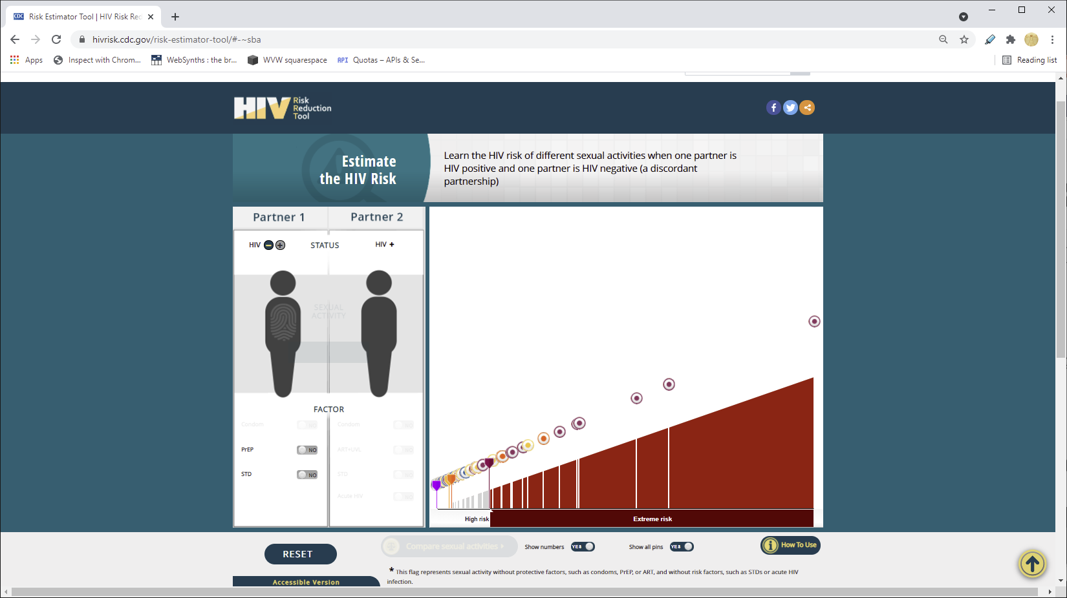

Slide 5
HIV Risk Behaviors
The risk of getting HIV varies widely depending on the type of exposure or behavior (such as sharing needles or having sex without a condom). Some exposures to HIV carry a much higher risk of transmission than other exposures. For some exposures, while transmission is biologically possible, the risk is so low that it is not possible to put a precise number on it. But risks do add up over time. Even relatively small risks can add up over time and lead to a high lifetime risk of getting HIV. In other words, there may be a relatively small chance of acquiring HIV when engaging in a risk behavior with an infected partner only once; but, if repeated many times, the overall likelihood of becoming infected after repeated exposures is actually much higher.
The table below lists the risk of transmission per 10,000 exposures for various types of exposures.
Estimated Per-Act Probability of Acquiring HIV from an Infected Source, by Exposure Act*
Estimated Per-Act Probability of Acquiring HIV from an Infected Source, by Exposure Act
Type of Exposure | Risk per 10,000 Exposures
Parenteral
Blood Transfusion | 9,250
Needle-Sharing During Injection Drug Use | 63
Percutaneous (Needle-Stick) | 23
Sexual
Receptive Anal Intercourse | 138
Insertive Anal Intercourse | 11
Receptive Penile-Vaginal Intercourse | 8
Insertive Penile-Vaginal Intercourse | 4
Receptive Oral Intercourse | Low
Insertive Oral Intercourse | Low
Other^
Biting | Negligible
Spitting | Negligible
Throwing Body Fluids (Including Semen or Saliva) | Negligible
Sharing Sex Toys | Negligible

